Slide 1
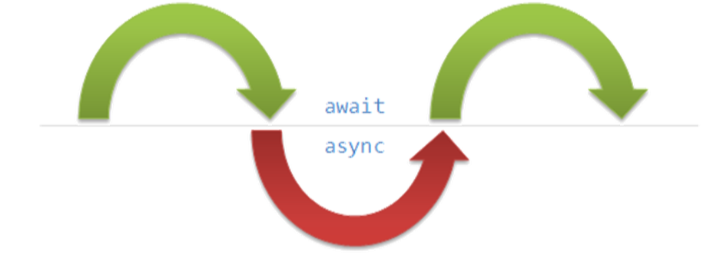
Asynchronous Processing
Writing Concurrent Code in C#
SoftUni Team
Technical Trainers
Software University
https://softuni.bg

Slide 2
Table of Contents
Synchronous Programming
Asynchronous Programming
Threads
Call Stack and Thread-Safety
Tasks in C# (async and await)
Data Parallelism & Concurrency

Slide 3
Have a Question?
sli.do #csharp-web

Slide 4

Synchronous Programming
Benefits and Drawbacks

Slide 5
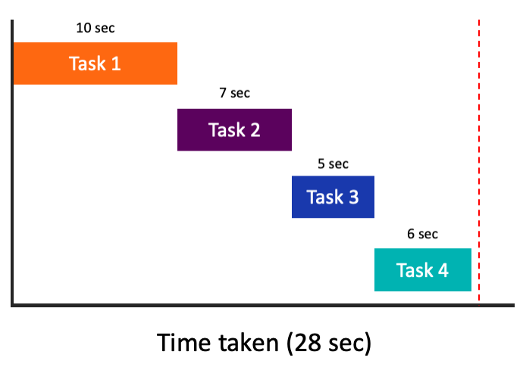
Synchronous Programming
Executing program components sequentially
i.e. "Sequential programming"
Actions happen one after another
Components wait for previous
components to finish
Program resources are
accessible at all points

Slide 6
Synchronous Code
static void Main()
{
int n = int.Parse(Console.ReadLine());
PrintNumbersInRange(0, 10);
Console.WriteLine("Done.");
}
static void PrintNumbersInRange(int a, int b)
{
for (int i = a; i <= b; i++)
{
Console.WriteLine(i);
}
}
int n = int.Parse(..)
PrintNumbersInRange()
Console.WriteLine(..)
...
Synchronous code is executed step by step

Slide 7
Synchronous Code – Long Running Operation
Console.Write("Enter your name: ");
string name = Console.ReadLine();
for (int i = 0; i < int.MaxValue; i++)
{
// Execute some operations here
}
Console.WriteLine($"Hello, {name}!");
You will have to wait for the long-running operation to finish before you can see the greeting

Slide 8

Synchronous Programming Drawbacks
If one component is blocked, the entire program is blocked
UI may become unresponsive
No utilization of multi-core systems
CPU-demanding tasks delay execution of all other tasks
Accessing resources blocks entire program
Especially problematic with web resources

Slide 9

Asynchronous Programming
Benefits and Drawbacks

Slide 10
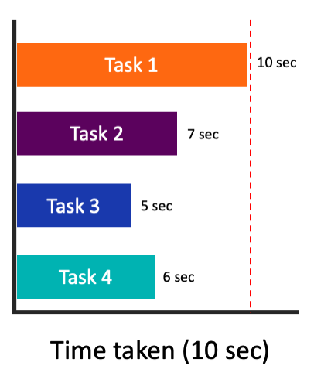
Asynchronous Programming
Program components can execute in parallel
Some actions run alongside other actions
Each action can happen in a separate thread
Independent components don't wait for each other
Program resources shared between threads
If one thread uses a resources, others shouldn't use it

Slide 11
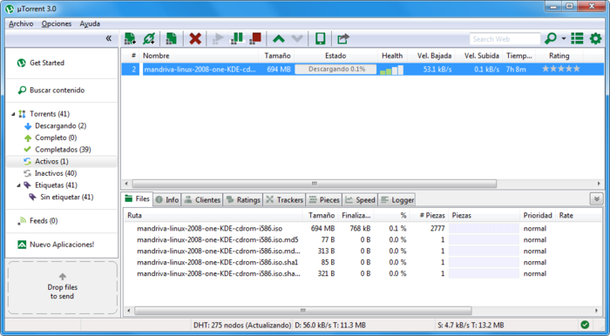

Asynchronous Programming – Benefits
If a component is blocked, other components still run
UI runs separately and always remains responsive
Utilization of multi-core systems
Each core executes one or more threads
CPU-demanding tasks run on "background" threads
Resource access runs on "background" threads

Slide 12
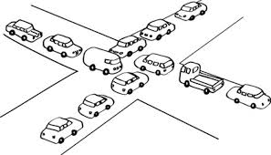
Asynchronous Programming – Drawbacks
Hard to know which code parts are running at a specific time
Harder than usual to debug
Have to protect resources
One thread uses a resource
Other threads must wait for the resource
Hard to synchronize resource access
Deadlocks can occur

Slide 13
Asynchronous Code
Asynchronous programming allows the execution of code simultaneously
int n = int.Parse(Console.ReadLine());
PrintNumbersInRange(0, 100);
var task = Task.Run(() =>
PrintNumbersInRange(100, 200));
Console.WriteLine("Done.");
task.Wait();
int n = int.Parse(..)
for (0..100)
Console.WriteLine(…)
for (100..200)
Wait()

Slide 14

Threads
Call Stack, Thread-Safety, Exception Handling

Slide 15
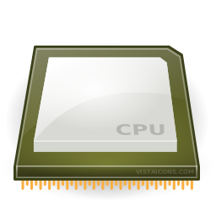
Instruction Execution
Each program's code is translated to CPU instructions
Program.cs
int a = 5;
int b = 4;
Console.WriteLine(a + b);
Compilation
Program.exe
Single-Core CPU
00DA2655 mov dword ptr [ebp-40h],5
00DA265C mov dword ptr [ebp-44h],4
00DA2663 mov ecx,dword ptr [ebp-40h]
00DA2666 add ecx,dword ptr [ebp-44h]
00DA2669 call 73B5A920
00DA266E nop
Instructions are executed one by one

Slide 16
Multi-Tasking
A computer can run many processes (applications) at once
But each CPU core can only execute one instruction at a time
Parellelism is achieved by the operating system's scheduler
Grants each thread a small interval of time to run
program.exe
chrome.exe
winamp.exe
system.exe
program.exe
...
0 5 10 15 20 25 ms
Notes:
s

Slide 17
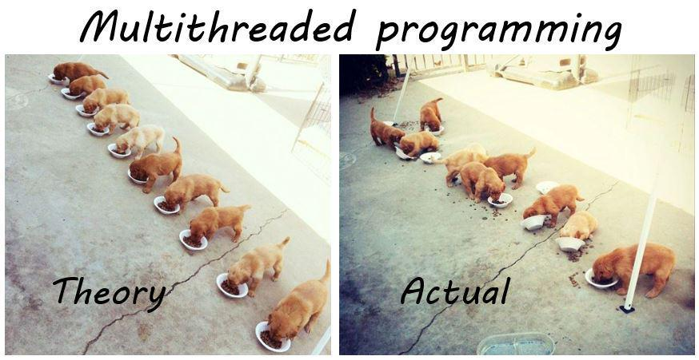
Threads
A thread is a fundamental unit of code execution
Commonly, processes (programs) use more than one thread
In .NET, there is always more than one thread (e.g. GC)
Each thread has a memory area associated with it known as a Call Stack
Stores local variables
Stores the currently invoked methods in order of invocation

Slide 18
Threads in C#
Threads in C# can be created using the System.Thread class
Constructor accepts a method (delegate) to execute on a separate thread
Thread thread = new Thread(() =>
{
for (int i = 0; i < 10; i++)
{
Console.WriteLine(i);
}
});

Slide 19
System.Thread
Start() – schedules the thread for execution
Join() – waits for the thread to finish its work (blocks the calling thread)
Thread primes = new Thread(() => PrintPrimesInRange(1, 10000));
primes.Start();
Console.WriteLine("Waiting for thread to finish work...");
primes.Join();

Slide 20
Problem: Even Numbers Thread
Print all even numbers in a given range
Printing should be executed on a separate thread
After all numbers are printed print "Thread finished work"
2
4
6
8
10
Thread finished work
1 10

Slide 21
Solution: Even Numbers Thread
// TODO: read start and end numbers
Thread evens = new Thread(() =>
PrintEvenNumbers(start, end));
evens.Start();
evens.Join();
Console.WriteLine("Thread finished work");
// TODO: implement method PrintEvenNumbers

Slide 22
Thread – Example
List<long> numbers = new List<long>();
Thread t = new Thread(() =>
SumOddNumbers(numbers, 10, 100000000L));
t.Start();
Console.WriteLine("What should I do?");
while (true)
{
string command = Console.ReadLine();
if (command == "exit") break;
}
t.Join();
Console interface
remains unblocked

Slide 23
Thread Stack
Each thread has its own stack
The start (bottom) of the stack is the method from which the thread began execution
Each method (frame) stores local variables
...
IsPrime()
PrintAllPrimes()
Main()
...
IsValidUrl
DownloadAsync
background thread
main thread

Slide 24

Thread Race Conditions
A race condition occurs when two or more threads access shared data and they try to change it at the same time
List<int> numbers = Enumerable.Range(0, 10000).ToList();
for (int i = 0; i < 4; i++)
{
new Thread(() =>
{
while (numbers.Count > 0)
numbers.RemoveAt(numbers.Count - 1);
}).Start();
}

Slide 25

Thread Safety
A thread-safe resource can be safely accessed by multiple threads
lock keyword grants access to only one thread at a time
Avoids race conditions
Blocks any other threads until the lock is released
lock (numbers)
{
if (numbers.Count == 0) break;
int lastIndex = numbers.Count - 1;
numbers.RemoveAt(lastIndex);
}

Slide 26
Exception Handling
Exceptions cannot be handled outside a thread
try
{
new Thread(DoWork).Start();
}
catch (Exception ex)
{
Console.WriteLine("Exception!");
}
This part will never be reached
public static void DoWork()
{
throw new ArgumentNullException();
}

Slide 27
Exception Handling – the Right Way
new Thread(DoWork).Start();
public static void DoWork()
{
try
{
throw new ArgumentNullException();
}
catch (Exception ex)
{
Console.WriteLine("Exception handled!");
}
}
Exceptions should be handled inside the executed method(s)

Slide 28

Tasks in C#
Task Parallel Library

Slide 29
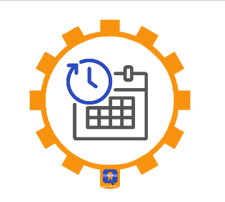
Tasks in C#
A task is a high-level representation of concurrent work
Runs in parallel with the main thread
May not run on a new thread (the CLR decides)
Offers several operations
Creating, running and returning result
Continuing with another task (chaining several operations)
Proper exception handling
Progress/state reports

Slide 30
Creating Tasks in C#
Creating tasks can be done in several ways
Initialize a new Task object
Task.Run()
Task.Factory.StartNew() – enables additional task customization
Task task = new Task(() => { Console.WriteLine(""); });
Task.Run(() => TraverseMatrix());
Task.Factory.StartNew(() => CopyFileContents("got-s03ep1.avi"),
TaskCreationOptions.LongRunning);

Slide 31
Generic Tasks
Task<T> is a task that will return a result sometime in the future
Task<long> task = Task<long>.Run(() =>
{
long sum = 0;
for (int i = 0; i < 10000; i++) sum += i;
return sum;
});
Console.WriteLine(task.Result);
Blocks the calling thread until the task returns a result

Slide 32
Live Demo: Sum Primes in Range
Sum all prime numbers in given range (1 to 1000000000)
Read commands and print the result only on command "show"
show
5736397
Print
show
5736397
show
5736397
If the operation time is too long, you will have to wait for the calculations to finish before you can continue reading next command

Slide 33
Solution: Sum Primes in Range
public static void Main()
{
while (true)
{
var command = Console.ReadLine();
if (command == "show")
{
var result = SumAsync();
Console.WriteLine(result);
}
}
}

Slide 34
Solution: Sum Primes in Range
private static long SumAsync()
{
return Task.Run(() =>
{
long sum = 0;
for (int i = 1; i < 1000; i++)
{
if (i % 2 == 0) sum += i;
}
return sum;
}).Result;
}

Slide 35
Live Demo: Sum Primes in Background
Sum all prime numbers in given range (1 to 1000000000)
Leave the console interface unblocked while calculating the sum
Read commands and print the result only on command "show"
Stop calculating on command "exit"
show
2959741628302556
show
163997016098667950
exit
The calculation runs in the background until stopped

Slide 36
Solution: Sum Primes in Background
public static void Main()
{
long sum = 0;
var task = Task.Run(() =>
{
for (long i = 0; i < 1000000000; i++)
if (i % 2 == 0) sum += i;
});
while (true) {
var line = Console.ReadLine();
if(line == "exit")
return;
else if(line == "show")
Console.WriteLine(sum);
}
}
Task running in the background

Slide 37
Task Exception Handling
Exceptions that have occurred within the body of a Task can be captured and handled outside of it
var task = SliceAsync(VideoPath, DestinationPath, 5);
try
{
task.Wait();
}
catch (AggregateException ex)
{
// Handle exception...
}
You can use the AggregateException to wrap all exceptions thrown by different threads

Slide 38
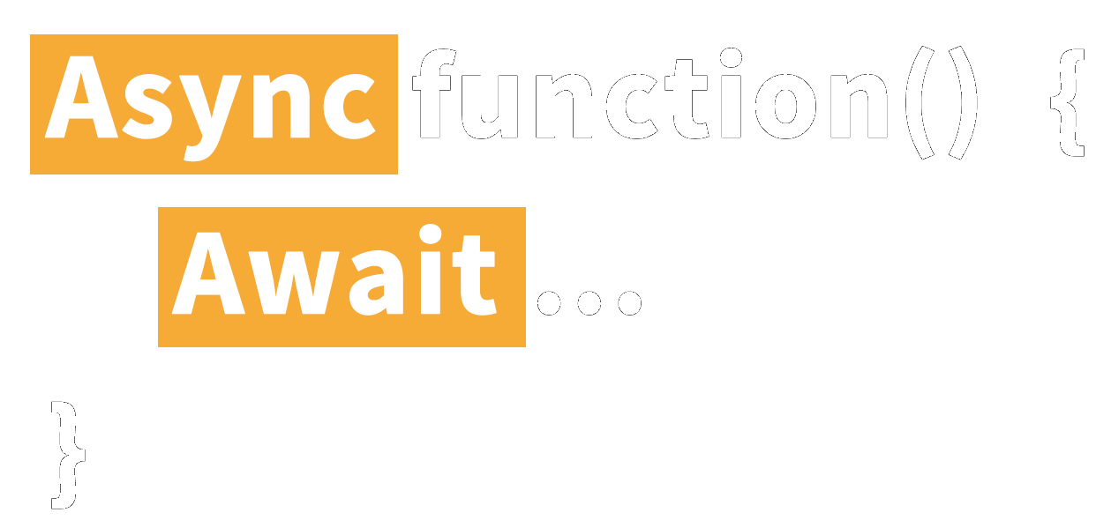
Async and Await
Keywords for Asynchronous Operations

Slide 39
Tasks with Async and Await (1)
The keywords async and await are always used together
async hints the compiler that the method might run in parallel
Does not make a method run asynchronously (await makes it)
Tells the compiler "this method could wait for a resource or operation"
If it starts waiting, return to the calling method
When the wait is over, go back to called method
static async void SliceFileAsync(string file, int parts)

Slide 40
Tasks with Async and Await (2)
await is used in a method which has the async keyword
Saves the context in a state machine
Marks waiting for a resource (a task to complete)
Resource should be a Task<T>
Returns T result from Task<T> when it completes
await DownloadStringAsync("https://softuni.org");
Returns Task<string>

Slide 41
Async and Await – Example
static void Main()
{
DownloadFileAsync(FileUrl, "book.pdf");
// Do some other work
}
static async void DownloadFileAsync(string url, string fileName)
{
Console.WriteLine("Downloading...");
await Task.Run(() =>
{
// Download the file
});
Console.WriteLine("Download successful.");
}
After the method is over the calling thread gets back to the calling method
The calling thread exits the method on await
When the waiting is over, the calling thread proceeds with method execution

Slide 42
Build-in Async Methods – GetStringAsync
Access to web resources with HttpClient class
Web access with HttpClient class
File processing with FileStream class
GetStringAsync();
GetAsync();
PostAsync();
ReadAsync();
WriteAsync();

Slide 43
Build-in Async Methods: Get Async
Download a file without blocking the console interface
public static async Task GetAsync(string uri = "https://httpbin.org/get")
{
using (HttpClient client = new HttpClient());
{
using (var r = await client.GetAsync(new Uri(uri)))
{
string result = await r.Content.ReadAsStringAsync();
Console.WriteLine(result);
}
}
}
Base class for sending HTTP requests and receiving HTTP responses

Slide 44
Build-in Async Methods: Get Async
Download a file without blocking the console interface
public static async Task GetAsync(string uri = "https://httpbin.org/get")
{
using (HttpClient client = new HttpClient());
{
using (var r = await client.GetAsync(new Uri(uri)))
{
string result = await r.Content.ReadAsStringAsync();
Console.WriteLine(result);
}
}
}
Sends a GET request to the specified Uri

Slide 45
Build-in Async Methods: Get Async
Download a file without blocking the console interface
public static async Task GetAsync(string uri = "https://httpbin.org/get")
{
using (HttpClient client = new HttpClient());
{
using (var r = await client.GetAsync(new Uri(uri)))
{
string result = await r.Content.ReadAsStringAsync();
Console.WriteLine(result);
}
}
}
Base class representing an HTTP entity body and content headers

Slide 46
Build-in Async Methods: Post Async
Download a file without blocking the console interface
public static async Task PostAsync(string url, string data)
{
HttpClient client = new HttpClient();
StringContent queryString = new StringContent(data);
var response = await client.PostAsync(new Uri(url), queryString);
string responseBody = await response.Content.ReadAsStringAsync();
Console.WriteLine(responseBody);
}
Sends a POST request to the specified Uri with the specified query string

Slide 47
Build-in Async Methods: GetStringAsync
Download the HTML of a given URL
static async Task<string> GetWebsiteHtmlAsync(string websiteUrl)
{
HttpClient client = new HttpClient();
string websiteHtml = await client.GetStringAsync(websiteUrl);
Console.WriteLine("Downloaded html");
return websiteHtml;
}

Slide 48
Build-in Async Methods: ReadAsync
Read a file without blocking the console interface
public static async Task<string> ReadFileAsync(string filename)
{
byte[] result;
Console.WriteLine("Reading...");
using (FileStream reader = File.Open(filename, FileMode.Open))
{
result = new byte[reader.Length];
await reader.ReadAsync(result, 0, (int)reader.Length);
Console.WriteLine("File readed");
}
return System.Text.Encoding.UTF8.GetString(result);
}

Slide 49
Build-in Async Methods: WriteAsync
static async Task SaveFile(string filename, byte[] data)
{
using (FileStream stream = new FileStream(filename, FileMode.OpenOrCreate))
{
int length = data.Length;
await stream.WriteAsync(data, 0, length);
}
}

Slide 50

Data Parallelism & Concurrency

Slide 51
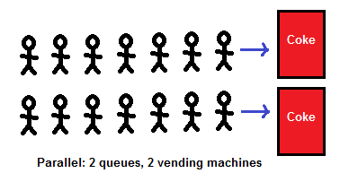
Data Parallelism (Task Parallel Library)
Data parallelism - scenarios in which the same operation is performed concurrently on elements in a collection
The Task Parallel Library (TPL) supports data parallelism through the System.Threading.Tasks.Parallel class
This class provides method-based parallel implementations of for and foreach loops.

Slide 52
Data Parallelism
Parallel.For()
Parallel.ForEach()
var elements = ...; // Some Collection
Parallel.For(0, elements.Length, i => {
Process(elements[i]);
});
var elements = ...; // Some Collection
Parallel.ForEach(elements, item => {
Process(item);
});

Slide 53
Concurrent Collections
The System.Collections.Concurrent namespace provides several thread-safe collection classes
ConcurrentDictionary<TKey, TValue>
ConcurrentBag<T>
ConcurrentStack<T>
ConcurrentQueue<T>
Access to the elements of those collections is NOT always guaranteed to be thread-safe.

Slide 54
Parallel LINQ
Parallel LINQ operations can be done
PLINQ is an extension to LINQ to Objects
Not the same as LINQ to SQL!
Just call .AsParallel() on the collection
The compiler does the rest
int[] nums = new int[] { 1, 2, 3, 4, 5 }; var evenNumsParallel = from num in nums.AsParallel() where num % 2 == 0
select num;

Slide 55

Summary
A thread is a unit of code execution
Each thread has its own call stack
Multithreading
A program can do several parallel operations by using many threads
Used to offload CPU-demanding work so the main thread does not block
Can lead to synchronization issues and unexpected results
Tasks facilitate the work with multithreading
async and await keywords
…
…
…

Slide 56
Questions?
Notes:
56

Slide 57








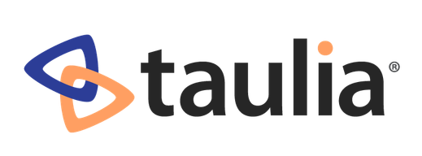




SoftUni Diamond Partners

Slide 58


Educational Partners

Slide 59
Trainings @ Software University (SoftUni)
Software University – High-Quality Education, Profession and Job for Software Developers
softuni.bg, about.softuni.bg
Software University Foundation
softuni.foundation
Software University @ Facebook
facebook.com/SoftwareUniversity
Software University Forums
forum.softuni.bg
59
Notes:
59

Slide 60

License
This course (slides, examples, demos, exercises, homework, documents, videos and other assets) is copyrighted content
Unauthorized copy, reproduction or use is illegal
© SoftUni – https://about.softuni.bg
© Software University – https://softuni.bg
Notes:
60

